Slide 1
GROUP BY
Dr. Jose Annunziato

Slide 2
The Group By Clause
Records are grouped by matching values in the column in the group by clause
Group by clause works with aggregate functions

Slide 3
Consider the following Enroll table
EId | StudentId | SectionId | Grade
1 | 1 | 1 | A
2 | 2 | 1 | A
3 | 3 | 1 | B
4 | 4 | 1 | B
5 | 5 | 2 | A
6 | 6 | 2 | A
7 | 7 | 2 | A
8 | 8 | 2 | B
9 | 9 | 3 | A
10 | 10 | 3 | B
11 | 11 | 3 | C
12 | 12 | 3 | D

Slide 4
Group By Syntax
SELECT group_column(s), other_columns
aggregate_function(aggregate_columns)
FROM table_name
WHERE any_columns operators values
GROUP BY group_column(s)

Slide 5
Group By Example…
Consider the following ORDERS table
OId | OrderDate | OrderPrice | Customer
1 | 2008/11/12 | 1000 | Alice
2 | 2008/10/23 | 1600 | Charlie
3 | 2008/09/02 | 700 | Alice
4 | 2008/09/03 | 300 | Alice
5 | 2008/08/30 | 2000 | Bob
6 | 2008/10/04 | 100 | Charlie

Slide 6
…Group By Example
We can calculate the sum for each customer
SELECT Customer, SUM(OrderPrice), OrderPrice (?)
FROM Orders
GROUP BY Customer
Customer | SUM(OrderPrice) | OrderPrice (?)
Alice | 2000 | 1000, 300, 700 (?)
Charlie | 1700
Bob | 2000

Slide 7
Omitting Group By
Using aggregate function, but omitting group by clause, generates single value, one big group
SELECT Customer, SUM(OrderPrice) FROM Orders
GROUP BY Customer
The SUM(OrderPrice) column is the single group, single value
Customer column has row per each input row
Customer | SUM(OrderPrice)
Alice | 5700
Charlie | 5700
Alice | 5700
Alice | 5700
Bob | 5700
Charlie | 5700

Slide 8
Grouping By Multiple Columns
Records belong to same group if fields in columns have same values
Following query groups records only if they have the same Customer name and OrderDate
SELECT Customer, OrderDate, SUM(OrderPrice)
FROM Orders
GROUP BY Customer, OrderDate
Then aggregates OrderPrice into a row per group

Slide 9
Another Example
Aggregate field names are vendor specific
Use AS keyword to assign meaningful names
"What are min and max graduation year, per major"
select s.MajorId,
min(s.GradYear) AS MinYr,
max(s.GradYear) AS MaxYr
from STUDENT s
group by s.MajorId

Slide 10
GROUP BY
LIMITATIONS
Dr. Jose Annunziato

Slide 11
Limitations of Group By
Group by is
Evaluated after WHERE clause - which records?
Before SELECT clause - lost fields :(
Cant have aggregation functions in where clause because records have not yet been grouped
Only non-computed fields allowed in select clause are grouping fields
Other input fields removed during grouping

Slide 12
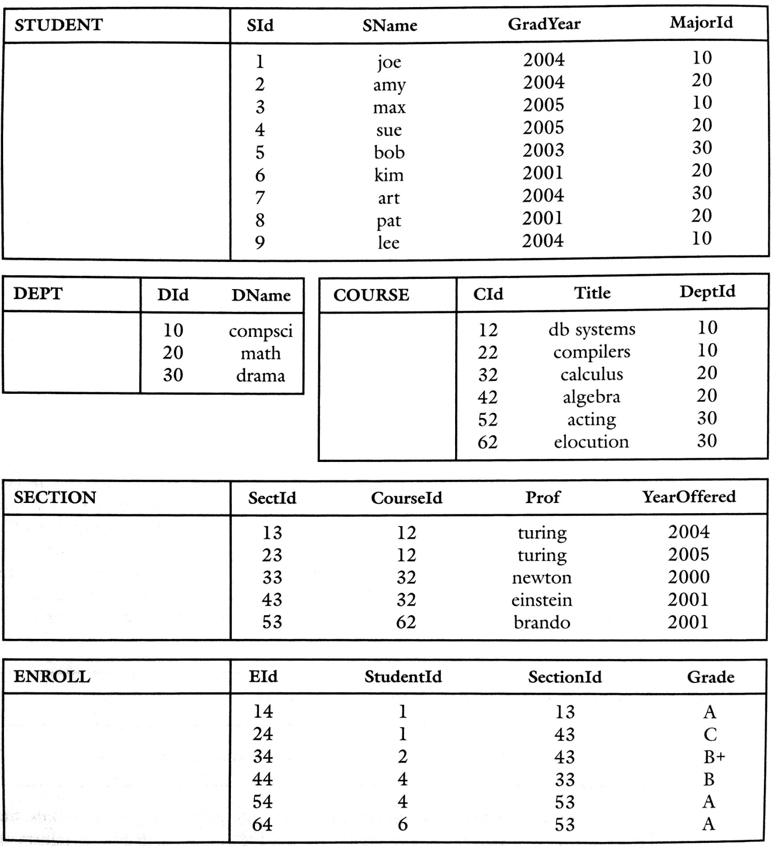

Slide 13
Limitation Examples
Consider counting number of A's given per section
Q83 = select e.SectionId, count(e.EId) as NumAs
from ENROLL e
where e.Grade = 'A'
group by e.SectionId
And max number of A's given in any section
Q84 = select max(q.NumAs) as MaxAs
from Q83 q

Slide 14
ENROLL |  |  |  |  | Q83 |  |  | Q84
EId | StudentId | SectionId | Grade |  | SectionId | NumAs |  | MaxAs
1 | 1 | 1 | A |  | 1 | 2 |  | 3
2 | 2 | 1 | A
3 | 3 | 1 | B
4 | 4 | 1 | B
5 | 5 | 2 | A |  | 2 | 3
6 | 6 | 2 | A
7 | 7 | 2 | A
8 | 8 | 2 | B
9 | 9 | 3 | A |  | 3 | 1
10 | 10 | 3 | B
11 | 11 | 3 | C
12 | 12 | 3 | D

Slide 15
Then Grouping Would Yield
Q83 = select e.SectionId, count(e.EId) as NumAs
from ENROLL e
where e.Grade = 'A'
group by e.SectionId
Q84 = select max(q.NumAs)
from Q83 q
Q83
SectionId | NumAs
1 | 2
2 | 3
3 | 1
Q84
MaxAs
3

Slide 16
Limitation Examples
But now how do we relate that max # of A's to the ID? How about adding the sectionId to the select?
Q84a = select max(q.NumAs) as MaxAs,
q.SectionId
from Q83 q
But query is illegal because by the time the aggregate function executes, the sectionIds will have been discarded
?
MaxAs | SectionId
3 | 2

Slide 17
Limitation Examples
Well, how about selecting the sectionId where the number of A's is the maximum?
Q84b = select q.SectionId
from Q83 q
where q.NumAs = max(q.NumAs)
But this query is also illegal since grouping has not happened yet and there is nothing to aggregate yet

Slide 18
Solution to Limitations
Solution is once we know the max, join with the original table to retrieve corresponding sectionId
So, the sections having the most A’s
Q85 = select Q83.SectionId
from Q83, Q84
where Q83.NumAs = Q84.MaxAs
Assuming sections have different numbers of As
But there is hope…

Slide 19
HAVING
Dr. Jose Annunziato

Slide 20
The Having Clause
SELECT column_name, aggregate_function(column_name) FROM table_name WHERE column_name operator value GROUP BY column_name HAVING aggregate_function(column_name) operator value
HAVING clause allows WHERE to use aggregate functions

Slide 21
Consider Orders table
SELECT Customer, SUM(OrderPrice) FROM Orders GROUP BY Customer HAVING SUM(OrderPrice) < 2000
OId | OrderDate | OrderPrice | Customer
1 | 2008/11/12 | 1000 | Boone
2 | 2008/10/23 | 1600 | Nilsen
3 | 2008/09/02 | 700 | Boone
4 | 2008/09/03 | 300 | Boone
5 | 2008/08/30 | 2000 | Jensen
6 | 2008/10/04 | 100 | Nilsen
Customer | SUM(OrderPrice)
Nilsen | 1700

Slide 22
Another Having Example
SELECT Customer, SUM(OrderPrice)
FROM Orders WHERE Customer='Boone' OR Customer='Jensen' GROUP BY Customer HAVING SUM(OrderPrice) > 1500
Customer | SUM(OrderPrice)
Boone | 2000
Jensen | 2000

